Slide 1
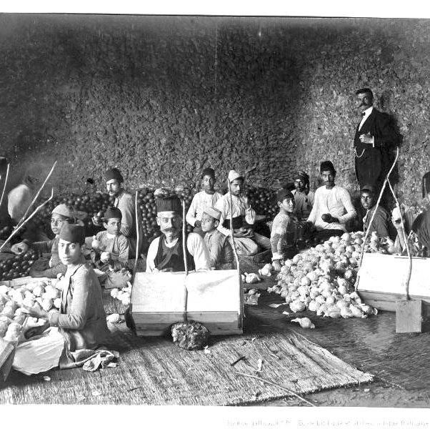
Was Palestine an ‘empty land’ in the nineteenth century?
Lesson 1

Slide 2
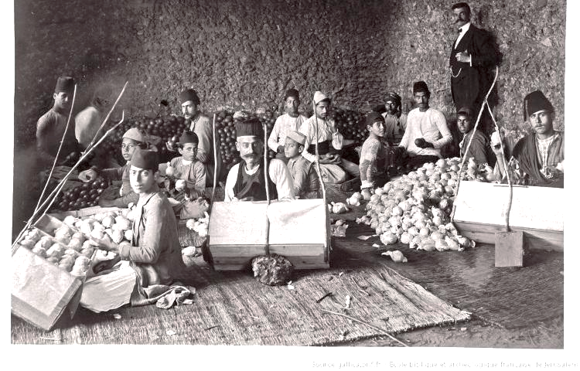
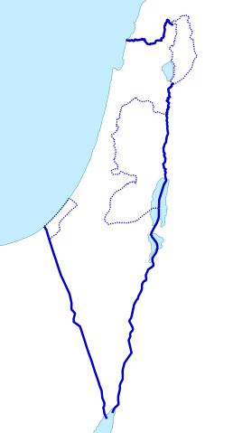
Learning objectives
By the end of this lesson, you should be able to:
Define Palestine-Israel and locate it on a map
Describe what life was like in Palestine in the nineteenth century
Assess the statement that Palestine was an ‘empty land’ in the nineteenth century

Slide 3
Starter activity
With the person next to you, answer these questions:
Q1) What three words come to mind when you hear “Palestine-Israel”?
Q2) What do you want to know about Palestine-Israel? Write down two questions
Next, join up with another pair and share your answers
Are your answers different? How and why?

Slide 4
1a. True or false? Write ‘true’ or ‘false’ under each statement
“The Palestine-Israel issue has been raging for centuries!”
“Palestine was an ‘empty land’ in the nineteenth century!”
“Zionism is just another word for Judaism!”
“The Palestine-Israel issue is all about religion!”
“The Palestine-Israel issue is unique… you can’t compare it with anything else!”
Please stick this sheet into your book. We will return to it in future lessons

Slide 5
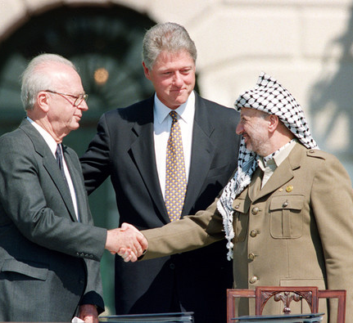
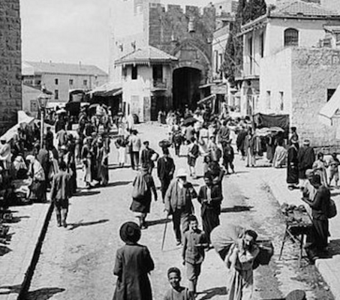
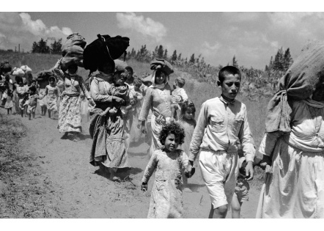
This course
Palestinian nationalism
Zionism
British involvement
The State of Israel
Events of 1948 and 1967
The ‘Peace Process’
Life in Palestine and Israel

Slide 6
Keywords
Transformation from a traditional rural society to an urban, industrial society
Ottoman Empire
A state that ruled vast areas of Western Asia, North Africa and South-eastern Europe between the 1300s and 1900s
Palestine-Israel
The land between the Mediterranean Sea and the River Jordan (also Israel/Palestine)
Modernisation
With the person next to you, can you match the keyword to the definition?
Next, start a glossary at the back of your book and add these keywords with their definitions

Slide 7
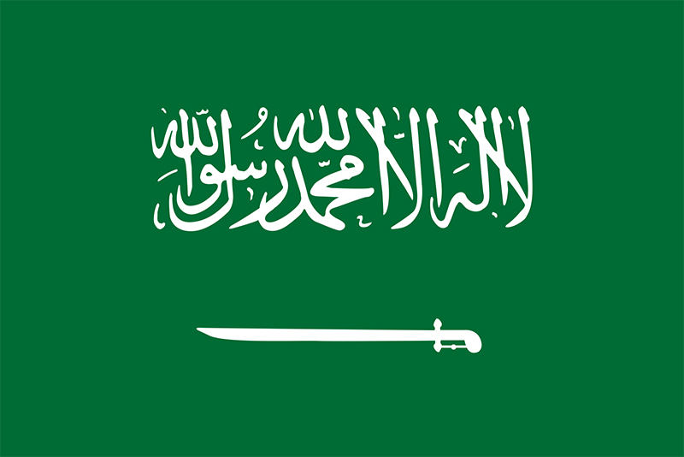
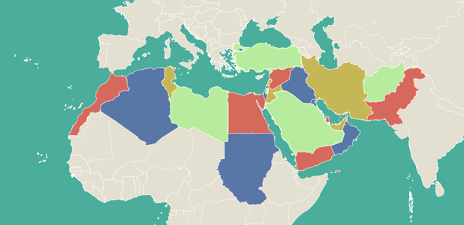
Extension: which flag belongs to Turkey, Egypt and Saudi Arabia?
Turkey
Saudi Arabia
Egypt
What countries can you identify on this map?
Turkey
Egypt
Saudi Arabia
Palestine-Israel

Slide 8
1b. Map activity
1b
Can you mark the following on your map?
You can use the textbook to help you
Jerusalem
Sea of Galilee
Naqab Desert
Dead Sea
5) Mediterranean Sea
6) River Jordan
7) Egypt
8) Lebanon
9) Syria
10) Jordan
11) Palestine-Israel

Slide 9
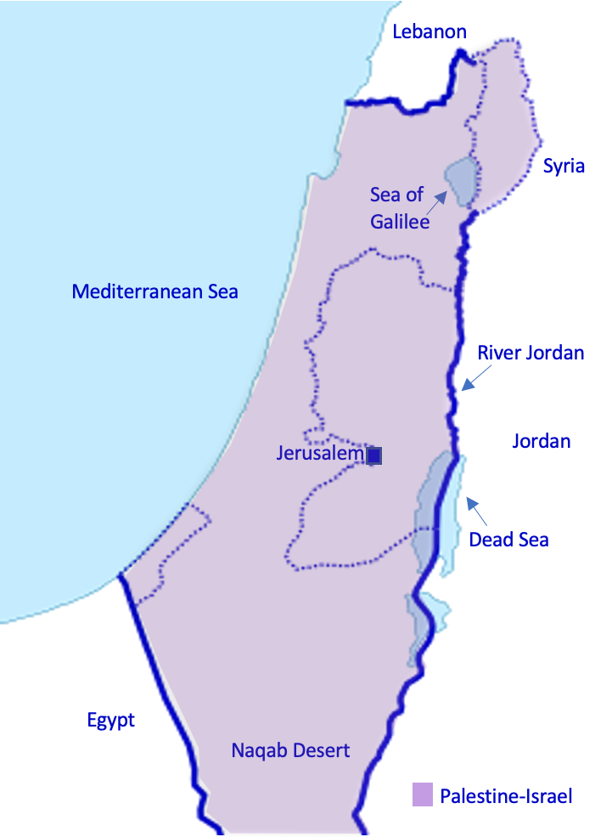

Slide 10
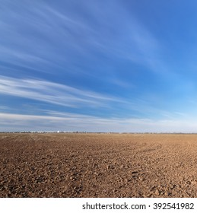
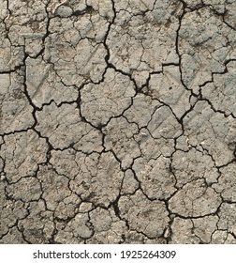
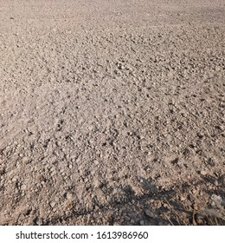
The ‘empty land’ myth
What do you imagine an ‘empty land’ to look like?
We are going to consider whether or not Palestine was an ‘empty land’ in the nineteenth century

Slide 11
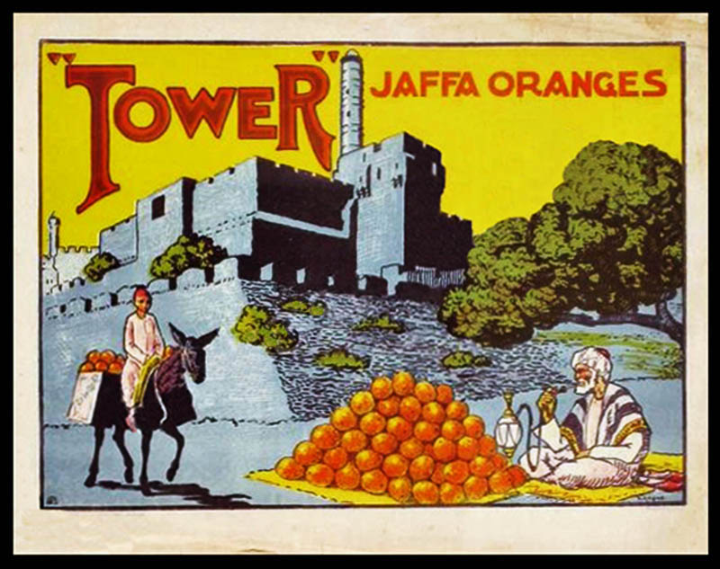
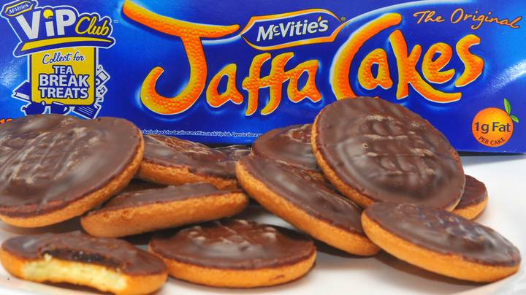
1800s Palestine
Significant modernisation occurred
There was a booming agricultural industry of olive oil, citrus fruits (eg. oranges from Jaffa), sugar cane, sesame seed, apples and grapes
Cotton was also produced, at first for candlewicks and then for the European textiles trade
A coastal network of ports and towns had thriving trade connections with Europe
There were vibrant urban centres in Haifa, Tiberias and Acre

Slide 12
Guess the number!
How many oranges were exported from Palestine between 1885 and 1895?
105 million!
That’s enough for every person in Canada to have a glass of orange juice today

Slide 13
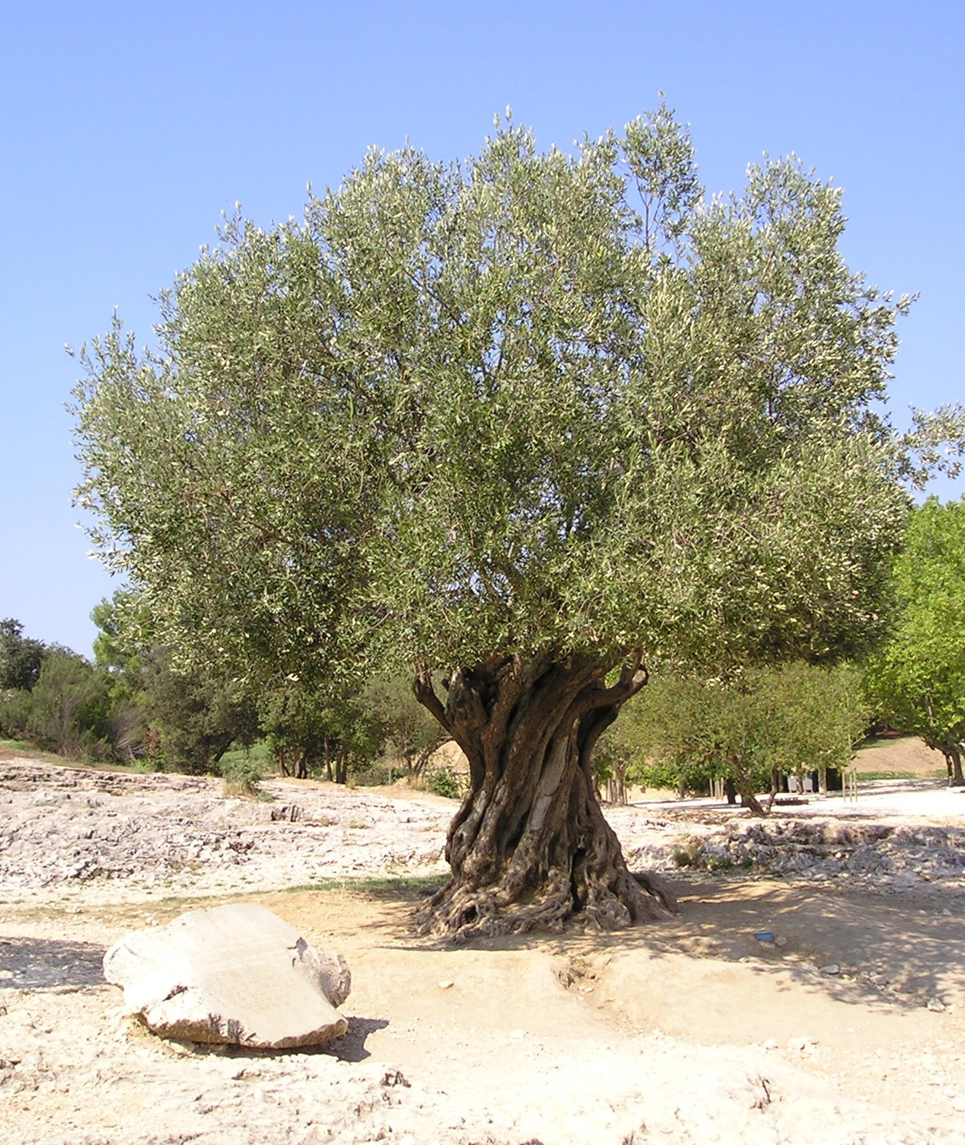
Guess the number!
How many litres of olive oil were exported from Palestine between 1885 and 1895?
7 million!
That’s enough to last every person in the UK for 4 months

Slide 14
Life in nineteenth century Palestine Watch the first 1 min 25 secs of this video

Slide 15
1c. What was life like in nineteenth century Palestine?
Use the textbook to make a spider diagram of life in nineteenth century Palestine:
Life in nineteenth century Palestine
Economic aspects
Social aspects
Political aspects

Slide 16
Homework
“Palestine was an ‘empty land’ in the nineteenth century”
How far do you agree with this statement?
Remember to justify and contextualize your answer.

Slide 17
Plenary activity
Write down two things you have learnt about life in nineteenth century Palestine today

